Slide 1
HOMEWORK 5 Due 12/03 00:00 Send to E3

Slide 2
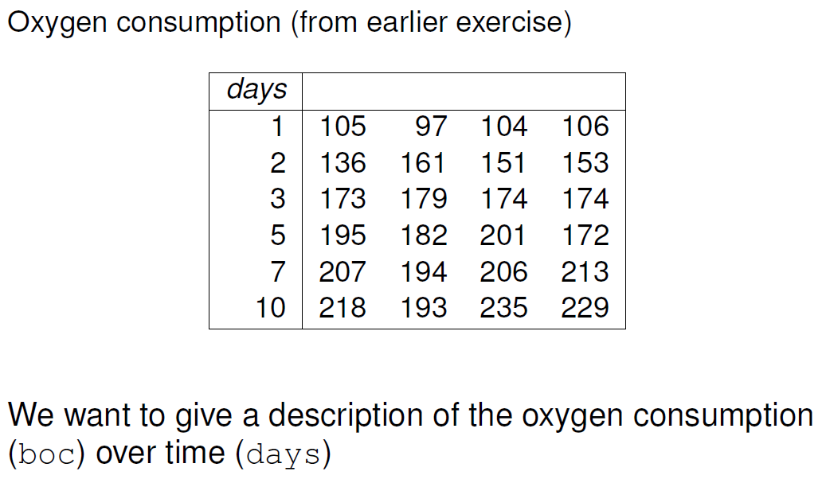
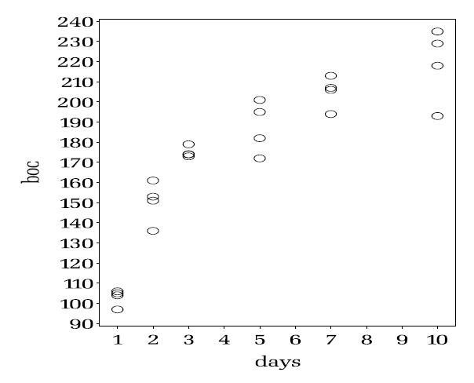
1. (50%) Find some appropriate nonlinear function with two parameters, and do a nonlinear regression (Hint. See the introduction pdf file on E3.)
2. (50%) Do a hypothesis testing on the coefficients, both through linearization and through likelihood approach.

